Slide 1
Programming robust LLM Agents for assisting scientific tasks
ISMB 2026 tutorial

Slide 2
Today's topics
LLM basics
Tools
Structured results & validators
Multi-agents
Docker
[Bonus] Use case: autonomous ML agent
Notes:
Everything above is in the notebook. We'll move section by section — code, run, discuss, then move on. The bonus sections are yours to take home if we run long.

Slide 3
Robustness
Control
Custom Agents
Codex
Claw
LLM
Capability + Cost

Slide 4
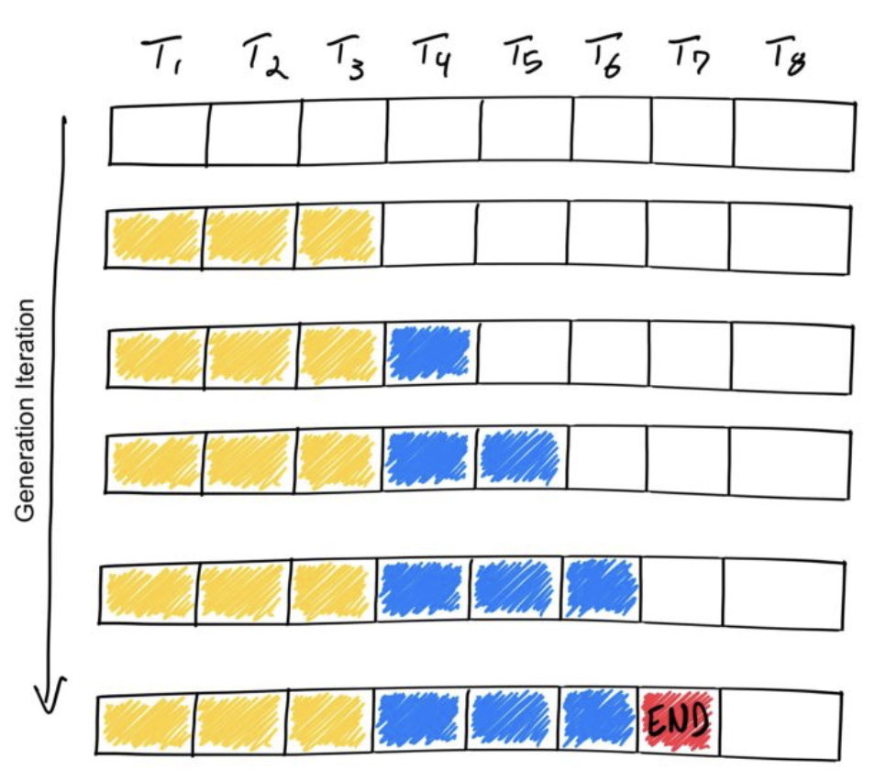
Token generation
Question
LLM
1 token at a time text completion
Chats don’t show helper tokens
Answer

Slide 5
Context and Prompting
Input to the model (including system messages, user messages, and its own)
Can be huge but limited (1mil tokens)
Emerging property - in-context learning - enables prompting
System prompt: You are a math assistant, refuse any non-math questions.
User prompt: What is the weather today
Answer: I can’t help you with that.

Slide 6
Tools
You are a math assistant with calculator tools available to solve your tasks.
Available tools: [
{"name":"Add", "args":["x","y"]}
]
User: What is the sum of 5 and 10
Assistant: <call_tool>{"name": "Add", "args": {"x": 5, "y": 10}}</call_tool>
<tool_message>("15")</tool_message>
The sum is 15
FIRST USER MESSAGE
TRIGGER!
INJECTED

Slide 7
Coding exercise 01 - Tools
Open the VT6 chat
Check the chat for the link to the notebook
Check the chat for an API key and copy it into OPENROUTER_API_KEY

Slide 8
Structured outputs
We can guarantee JSON output
We can validate e.g. origin_year is positive
User prompt: Who is the best superhero? Answer in a json format with the following fields: name, origin_year, latest_movie
Answer:
{
"name": "Spider-Man",
"origin_year": 1962,
"latest_movie": "Spider-Man: Across the Spider-Verse"
}

Slide 9
Coding exercise 02 - Structured outputs & validators
Open the VT6 chat
Check the chat for the link to the notebook
Check the chat for an API key and copy it into OPENROUTER_API_KEY

Slide 10
BREAK
Back 10 mins

Slide 11
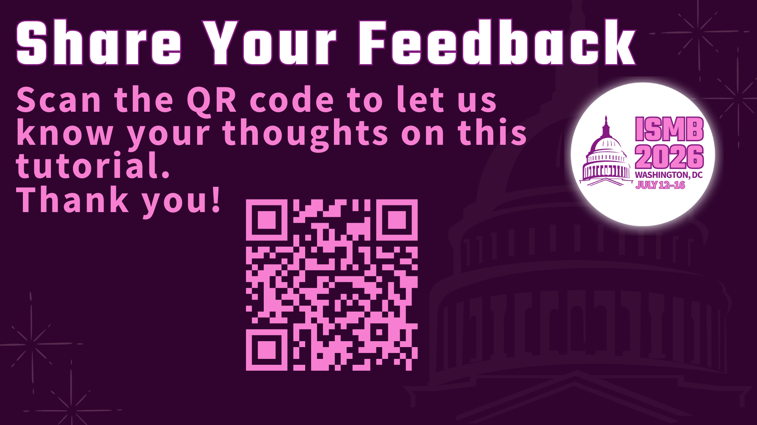

Slide 12
Multiple agents
User
User
Reasons for multiple agents
Context management
Passing only certain info and deps
Tool scope
LLM Configuration
Intermediate validation
Agent 1
Agent 1
Agent 2
Agent 2
Agent 3

Slide 13
Coding exercise 03 - Multi-Agent workflows
Open the VT6 chat
Check the chat for the link to the notebook
Check the chat for an API key and copy it into OPENROUTER_API_KEY

Slide 14




Running agents with Docker
run
Container 1
Build
run
run
Container 2
Dockerfile
Docker Image
Container 3

Slide 15

Sequence Class
GTCAGTCAGTCAGTCAGTCAGT 1
GTCAGTCAGTCAGTCACAGTAA 1
GGCATCGATCTTAGCATAAAACG 1
AACCTTCGAGGGCTATTCCCCA 1
GCCCATTCGACCTTTCAGCTAC 1
AATCTACTATCTTCTTAGGGCGA 1
ACCTTCCGGATTCGGAGATTCC 1
CCACCTTACTGACTATCTCGAGC 0
AACACACCAACTTGCGGGGGC 0
ACCATCTCAGACGCGGAGCGC 0
CCCCGAGGCGGGGACTTTTCC 0
TTTCGGCGGGAGGCGGCGGC 0
ACCTTACGGCGAGGGGGCACC 0
Dataset

Slide 16
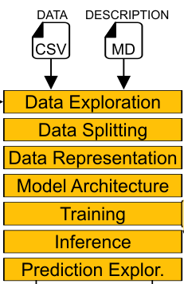
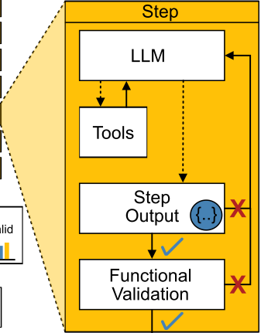
Agentomics

Slide 17
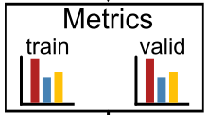


Iterative refinement process
Model
Experiment Design LLM

Slide 18



Model Evaluation & Selection
Agent environment
Iteration 1
Iteration 2
Iteration N
Train Set
Test set
= 0.82
= 0.89
= 0.87

Slide 19
Coding exercise 04 - Machine Learning Agent
Open the VT6 chat
Check the chat for the link to the notebook
Check the chat for an API key and copy it into OPENROUTER_API_KEY

Slide 20


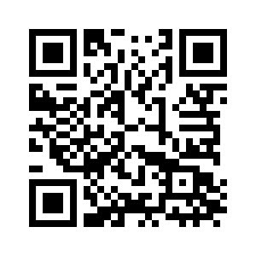
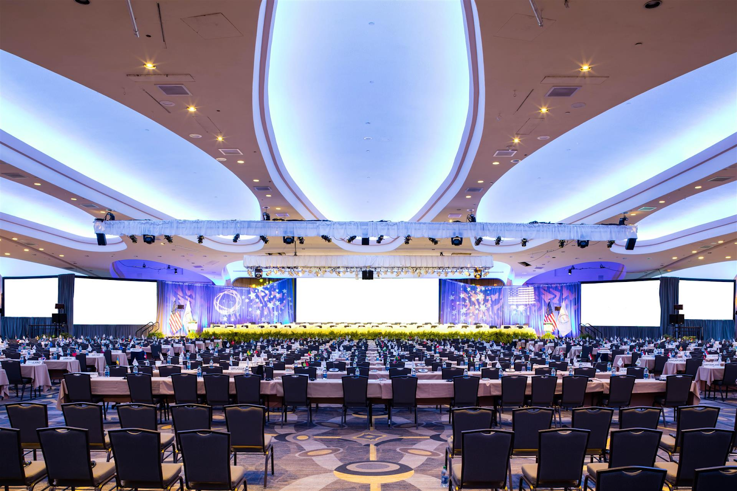
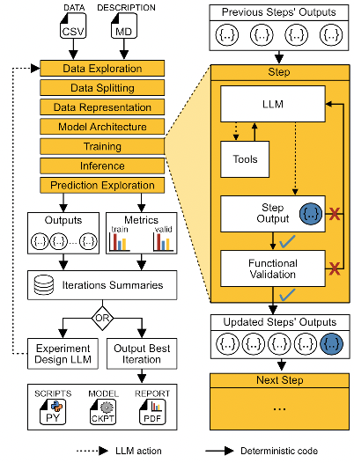
Proceedings talk
Wednesday 11:20-11:40
Poster C-127
Wednesday 10:00-11:00 + 16:00-16:40
Agentomics
Tutorial
bit.ly/DCTUTORIAL

